Slide 1
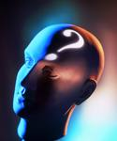
Abnormal Psychology A.K.A. Psychological Disorders
Patterns of thoughts, feelings, or behaviors that are deviant, distressful, and dysfunctional.

Slide 2
Deviant, Distressful & Dysfunctional What is abnormal depends on culture, time period, and environmental conditions.
Video Clip
Deviant behavior (going naked) in one culture may be considered normal, while in others it may lead to arrest.
Deviant behavior must accompany distress.
If a behavior is dysfunctional it is considered a disorder.
Carol Beckwith
In the Wodaabe tribe men wear costumes to attract women. In Western society this would be considered abnormal.

Slide 3
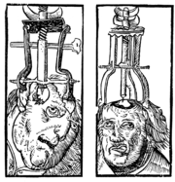
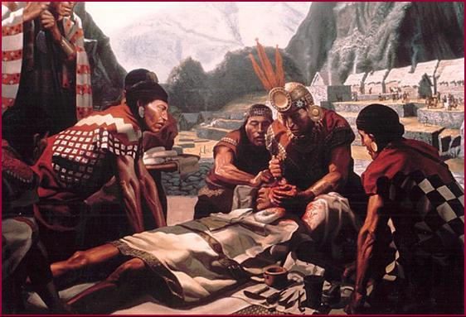
Early Theories
Abnormal behavior was evil spirits trying to get out.
Ancient treatments of psychological disorders include trephination, exorcism, being caged like animals, being beaten, burned, castrated, mutilated, or transfused with animal’s blood.

Slide 4
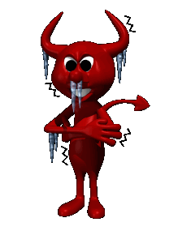
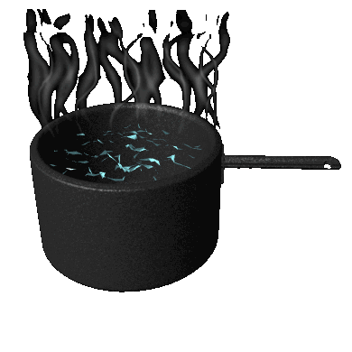
Early Theories
Another theory was to make the body extremely uncomfortable.

Slide 5
History of Mental Disorders
In the 1800’s, disturbed people were no longer thought of as madmen, but as mentally ill.
They were first put in hospitals.
Did this mean better treatment?

Slide 6
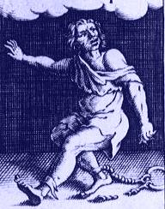
Early Mental Hospitals
They were nothing more than barbaric prisons.
The patients were chained and locked away.
Some hospitals even charged admission for the public to see the “crazies”, just like a zoo.

Slide 7
Philippe Pinel
French doctor who was the first to take the chains off and declare that these people are sick and “a cure must be found!!!”

Slide 8
Current Perspectives
Medical Perspective: psychological disorders are sicknesses and can be diagnosed, treated and cured.
Bio-Psycho-Social Perspective: assumes biological, psychological and sociocultural factors combine to interact causing psychological disorders.

Slide 9
Medical Model
When physicians discovered that syphilis led to mental disorders, they started using medical models to review the physical causes of these disorders.
Etiology: Cause and development of the disorder.
Diagnosis: Identifying (symptoms) and distinguishing one disease from another.
Treatment: Treating a disorder in a psychiatric hospital.
Prognosis: Forecast about the disorder.

Slide 10
Biopsychosocial Perspective
Assumes that biological, socio-cultural, and psychological factors combine and interact to produce psychological disorders.

Slide 11
Perspectives and Disorders
Psychological School/Perspective | Cause of the Disorder
Psychoanalytic/Psychodynamic | Internal, unconscious drives
Humanistic | Failure to strive to one’s potential or being out of touch with one’s feelings.
Behavioral | Reinforcement history, the environment.
Cognitive | Irrational, dysfunctional thoughts or ways of thinking.
Sociocultural | Dysfunctional Society
Biomedical/Neuroscience | Organic problems, biochemical imbalances, genetic predispositions.

Slide 12
Rates of Psychological Disorders
Notes:
OBJECTIVE 22| Discuss the prevalence of psychological disorders, and summarize the findings on the link between poverty and serious psychological disorders.

Slide 13
Rates of Psychological Disorders
The prevalence of psychological disorders during the previous year is shown below (WHO, 2004).

Slide 14
Rates of Psychological Disorders
The prevalence of psychological disorders during the previous year is shown below (WHO, 2004).

Slide 15
Risk and Protective Factors
Risk and protective factors for mental disorders (WHO, 2004).

Slide 16
Risk and Protective Factors

