Slide 1
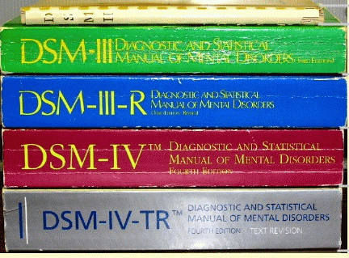
DSM-V
Diagnostic Statistical Manual of Mental Disorders: the big book of disorders.
DSM will classify disorders and describe the symptoms.
DSM will NOT explain the causes or possible cures.

Slide 2
Classifying Psychological Disorders
The American Psychiatric Association rendered a Diagnostic and Statistical Manual of Mental Disorders (DSM) to describe psychological disorders.
The most recent edition, DSM-IV-TR (Text Revision, 2000), describes 400 psychological disorders compared to 60 in the 1950s.
Notes:
OBJECTIVE 3| Describe the goals and content of the DSM-IV.

Slide 3
Two Major Classifications in the DSM
Neurotic Disorders
Psychotic Disorders
Distressing but one can still function in society and act rationally.
Person loses contact with reality, experiences distorted perceptions.
John Wayne Gacy

Slide 4
Multiaxial Classification
Axis I
Is a Clinical Syndrome (cognitive, anxiety, mood disorders [16 syndromes]) present?
Axis II
Is a Personality Disorder or Mental Retardation present?
Axis III
Is a General Medical Condition (diabetes, hypertension or arthritis etc) also present?
Axis IV
Are Psychosocial or Environmental Problems (school or housing issues) also present?
Axis V
What is the Global Assessment of the person’s functioning?

Slide 5
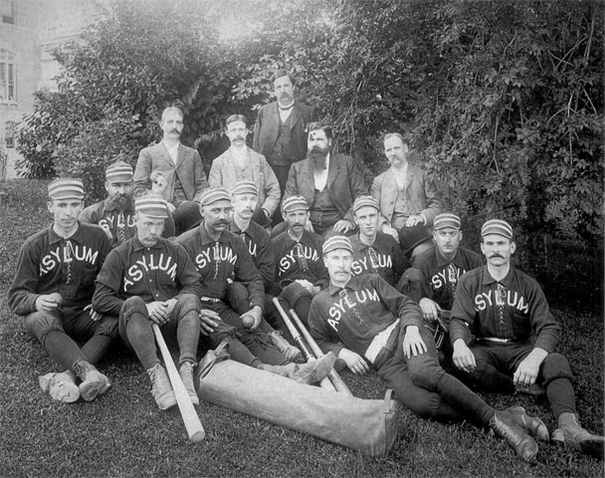
Labeling Psychological Disorders
Critics of the DSM argue that labels may stigmatize individuals.
Labels may be helpful for healthcare professionals when communicating with one another and establishing therapy.
“Insanity” labels raise moral and ethical questions about how society should treat people who have disorders and have committed crimes.
Theodore Kaczynski
(Unabomber)
Notes:
OBJECTIVE 4| Discuss the potential dangers and benefits of using diagnostic labels.
Classroom Exercise: The Effects of Labeling
Once a diagnostic label is attached to someone, we
come to see that person differently. Labels create
preconceptions that can bias our interpretations and
memories. One result is that erroneous diagnoses can
sometimes be self-confirming, because clinicians will
search for evidence in a client’s life history and hospital
behavior that is consistent with the diagnosis. David
Rosenhan, whose controversial demonstration of the
biasing power of diagnostic labels is reported in the
text, gives the example of one pseudopatient who told
the interviewer that he
had a close relationship with his mother but was rather
remote from his father during his early childhood.
During adolescence and beyond, however, his father
became a close friend, while his relationship with his
mother cooled. His present relationship with his wife was
characteristically close and warm. Apart from occasional
angry exchanges, friction was minimal. The children had
rarely been spanked.
Knowing the person was diagnosed as having schizophrenia,
the clinician “explained” the problem in the
following manner.
This white 39-year-old male . . . manifests a long history
of considerable ambivalence in close relationships,
which begins in early childhood. A warm relationship
with his mother cools during his adolescence. A distant
relationship to his father is described as becoming very
intense. Affective stability is absent. His attempts to control
emotionality with his wife and children are punctuated
by angry outbursts and, in the case of the children,
spankings. And while he says that he has several good
friends, one senses considerable ambivalence embedded
in those relationships also.

