Slide 1
Dissociative Disorders
Conscious awareness becomes separated (dissociated) from previous memories, thoughts, and feelings.
Symptoms
Having a sense of being unreal.
Being separated from the body.
Watching yourself as in a movie.

Slide 2
Psychogenic Amnesia
A person cannot remember things with no physiological basis for the disruption in memory.
Retrograde Amnesia
NOT organic amnesia.
Organic amnesia can be retrograde or antrograde.

Slide 3
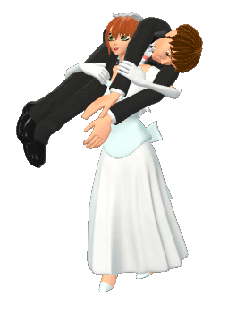
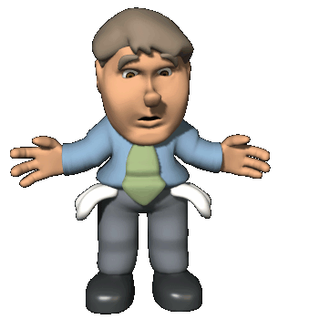
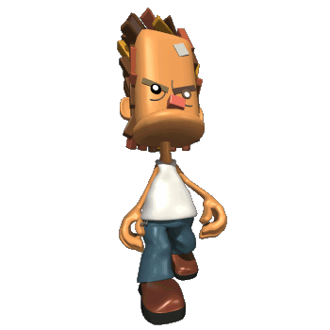
Dissociative Fugue
People with psychogenic amnesia that find themselves in an unfamiliar environment.

Slide 4
Dissociative Identity Disorder
Used to be known as Multiple Personality Disorder.
A person has several rather than one integrated personality.
People with DID commonly have a history of childhood abuse or trauma.

Slide 5
Dissociative Identity Disorder (DID)
People with DID commonly have a history of childhood trauma or abuse.
Lois Bernstein/ Gamma Liason
Video Clip
Sybil Dorsett (DID)

