Slide 1
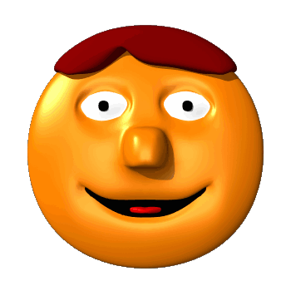
Mood Disorders

Slide 2
Mood Disorders
Psychological Disorders characterized by emotional extremes.
Dysthymic Disorder
Major Depressive Disorder
Seasonal Affective Disorder
Bipolar Disorder

Slide 3
Dysthymic Disorder
Suffering from mild depression every day for at least two years.

Slide 4
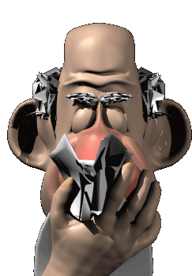
Depression
The common cold of psychological disorders
Signs Include
Lethargy and fatigue
Feelings of worthlessness
Loss of interest in family & friends
Loss of interest in activities

Slide 5
Depression

Slide 6
Depression

Slide 7
Major Depressive Disorder
A person, for no apparent reason, experiences two or more weeks of depressive moods.
Includes feelings of worthlessness and diminished interest or pleasure in most activities.

Slide 8
Seasonal Affective Disorder

Slide 9
Bipolar Disorder
Person alternates between the hopelessness and lethargy of depression and the overexcited state of mania.

Slide 10
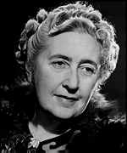
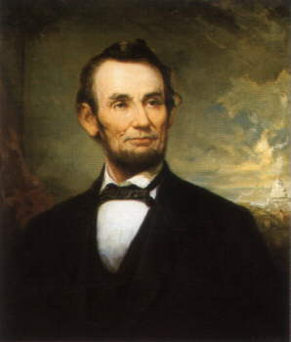
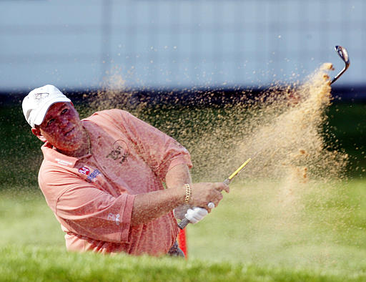
Famous People with Bipolar

Slide 11
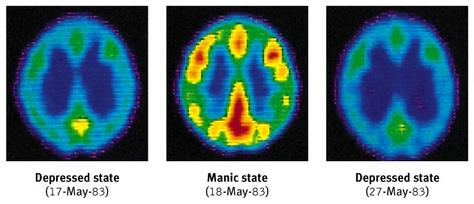
Bipolar Brain

