Slide 1
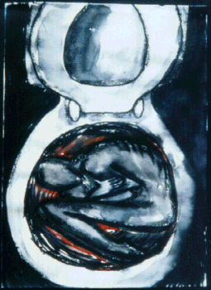
Eating Disorders
Bulimia Nervosa
Characterized by binging (eating large amounts of food) and purging (getting rid of the food).

Slide 2
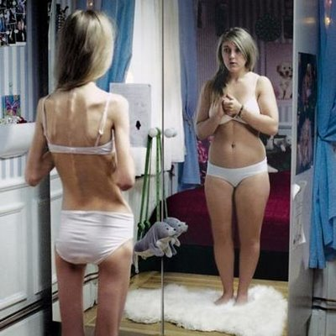
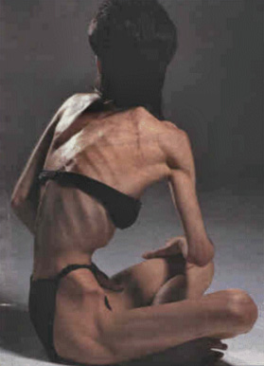
Anorexia Nervosa
Starve themselves to below 85% of their normal body weight.
See themselves as fat.
Vast majority are woman.
Click on the woman to watch a case study of an anorexic.

Slide 3
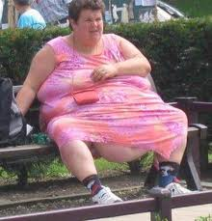
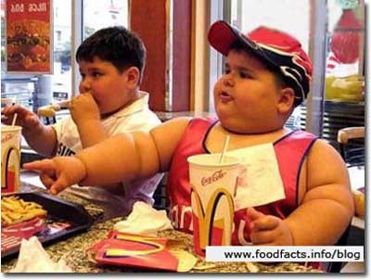
Obesity
Severely overweight to the point where it causes health issues.
Mostly eating habits but some people are predisposed towards obesity.
Click on the pictures to see some case studies on obesity.

Slide 4
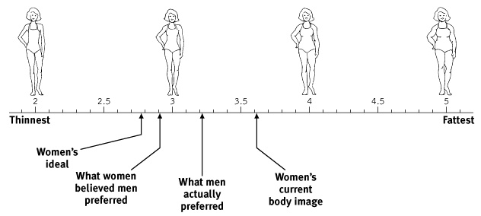
Body Image

