Slide 1
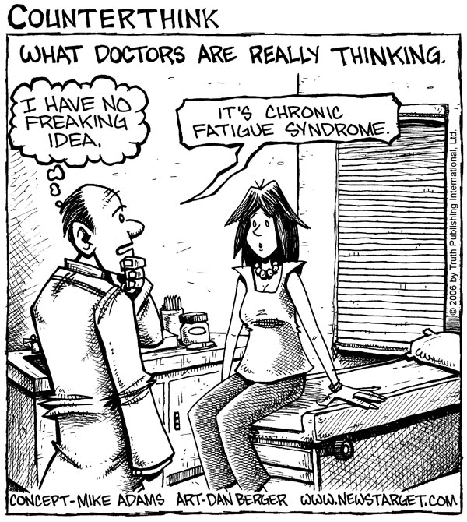
Somatoform Disorders
Occur when a person has physiological symptoms due to a psychological problem.
Medical exams rule out any physical cause.

Slide 3
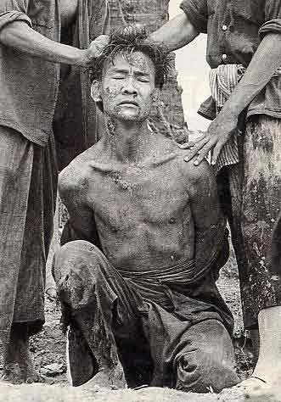
Conversion Disorder
Report the existence of severe physical problems with no biological reason.
Like blindness or paralysis.

Slide 4
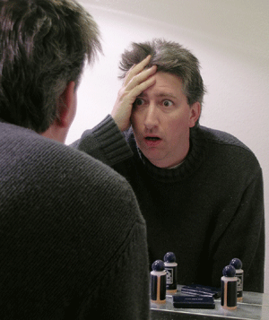
Hypochondriasis
Has frequent physical complaints for which medical doctors are unable to locate the cause.
They usually believe that the minor issues (headache, upset stomach) are indicative are more severe illnesses.

