Slide 1
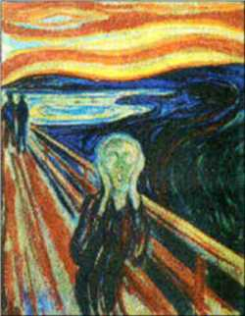
Schizophrenia
Video Clip
If depression is the common cold of psychological disorders, schizophrenia is the cancer.
Nearly 1 in a 100 suffer from schizophrenia, and throughout the world over 24 million people suffer from this disease (WHO, 2002).
Schizophrenia strikes young people as they mature into adults. It affects men and women equally, but men suffer from it more severely than women.

Slide 2
Symptoms of Schizophrenia
The literal translation is “split mind.” A group of severe disorders characterized by the following:
Disorganized and delusional thinking.
Disturbed perceptions.
Inappropriate emotions and actions.
Notes:
OBJECTIVE 16| Describe the symptoms of schizophrenia, and differentiate delusion and hallucinations.

Slide 3
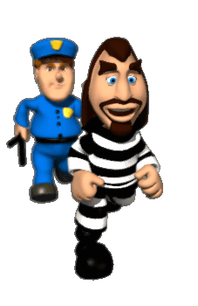
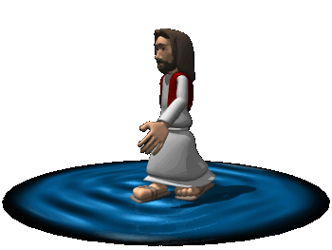
Disorganized & Delusional Thinking
This morning when I was at Hillside [Hospital], I was making a movie. I was surrounded by movie stars … I’m Marry Poppins. Is this room painted blue to get me upset? My grandmother died four weeks after my eighteenth birthday.”
Other forms of delusions include, delusions of persecution (“someone is following me”) or grandeur (“I am a king”).
This monologue illustrates fragmented, bizarre thinking with distorted beliefs called delusions (“I’m Mary Poppins”).

Slide 4
Disorganized & Delusional Thinking
Many psychologists believe disorganized thoughts occur because of selective attention failure (fragmented and bizarre thoughts). They cannot filter out information.

Slide 5
Disturbed Perceptions
A schizophrenic person may perceive things that are not there (hallucinations). Frequently such hallucinations are auditory and lesser visual, somatosensory, olfactory, or gustatory.
Photos of paintings by Krannert Museum, University of Illinois at Urbana-Champaign
August Natter, Witches Head. The Prinzhorn Collection, University of Heidelberg
L. Berthold, Untitled. The Prinzhorn Collection, University of Heidelberg

Slide 6
Inappropriate Emotions & Actions
A schizophrenic person may laugh at the news of someone dying or show no emotion at all (apathy).
Patients with schizophrenia may continually rub an arm, rock a chair, or remain motionless for hours (catatonia).

Slide 7
Positive and Negative Symptoms
Schizophrenics have inappropriate symptoms (hallucinations, disorganized thinking, deluded ways) that are not present in normal individuals (positive symptoms).
Schizophrenics also have an absence of appropriate symptoms (apathy, expressionless faces, rigid bodies) that are present in normal individuals (negative symptoms).

Slide 8
Chronic and Acute Schizophrenia
When schizophrenia is slow to develop (chronic/process) recovery is doubtful. Such schizophrenics usually display negative symptoms.
When schizophrenia rapidly develops (acute/reactive) recovery is better. Such schizophrenics usually show positive symptoms.

Slide 9
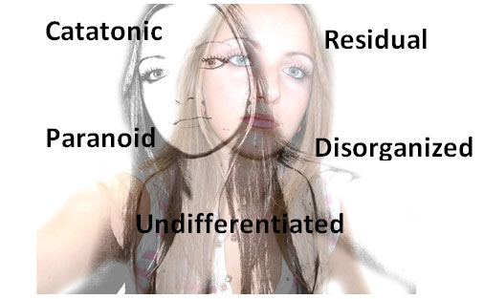
Subtypes of Schizophrenia
Schizophrenia is a cluster of disorders. These subtypes share some features, but there are other symptoms that differentiate these subtypes.
Notes:
OBJECTIVE 17| Distinguish the five subtypes of schizophrenia, and contrast chronic and reactive schizophrenia.

Slide 10
Subtypes

Slide 11
Understanding Schizophrenia
Schizophrenia is a disease of the brain exhibited by the symptoms of the mind.
Brain Abnormalities
Dopamine Overactivity: Researchers found that schizophrenic patients express higher levels of dopamine D4 receptors in the brain.
Notes:
OBJECTIVE 18| Outline some abnormal brain functions and structures associated with schizophrenia, and discuss the possible link between prenatal viral infections and schizophrenia.

Slide 12
Abnormal Brain Activity
Brain scans show abnormal activity in the frontal cortex, thalamus, and amygdala of schizophrenic patients. Adolescent schizophrenic patients also have brain lesions.
Paul Thompson and Arthur W. Toga, UCLA Laboratory of Neuro
Imaging and Judith L. Rapport, National Institute of Mental Health

Slide 13
Abnormal Brain Morphology
Schizophrenia patients may exhibit morphological changes in the brain like enlargement of fluid-filled ventricles.
Both Photos: Courtesy of Daniel R. Weinberger, M.D., NIH-NIMH/ NSC

Slide 14
Viral Infection
Schizophrenia has also been observed in individuals who contracted a viral infection (flu) during the middle of their fetal development.

Slide 15
Genetic Factors
The likelihood of an individual suffering from schizophrenia is 50% if their identical twin has the disease (Gottesman, 1991).
0 10 20 30 40 50
Identical
Both parents
Fraternal
One parent
Sibling
Nephew or niece
Unrelated
Notes:
OBJECTIVE 19| Discuss the evidence for a genetic contribution to the development of schizophrenia.

Slide 16
Genetic Factors
The following shows the prevalence of schizophrenia in identical twins as seen in different countries.

Slide 17
Psychological Factors
Psychological and environmental factors can trigger schizophrenia if the individual is genetically predisposed (Nicols & Gottesman, 1983).
The genetically identical Genain
sisters suffer from schizophrenia. Two more than others, thus there are contributing environmental factors.
Courtesy of Genain Family
Genain Sisters
Notes:
OBJECTIVE 20| Describe some psychological factors that may be early signs of schizophrenia in children.

Slide 18
Warning Signs
Video
Early warning signs of schizophrenia include:
1.
A mother’s long lasting schizophrenia.
2.
Birth complications, oxygen deprivation and low-birth weight.
3.
Short attention span and poor muscle coordination.
4.
Disruptive and withdrawn behavior.
5.
Emotional unpredictability.
6.
Poor peer relations and solo play.

