Slide 1
Personality Disorders
Psychological disorders characterized by inflexible and enduring behavior patterns that impair social functioning.

Slide 2
Paranoid Personality Disorder
Paranoid personality disorder is characterized by a distrust of others and a constant suspicion that people around you have sinister motives.

Slide 3
Paranoid Personality Disorder
They search for hidden meanings in everything and read hostile intentions into the actions of others.
They are quick to challenge the loyalties of friends and loved ones and often appear cold and distant to others. They usually shift blame to others and tend to carry long grudges.

Slide 4
Antisocial Personality Disorder
antisocial personality disorder is characterized by a lack of conscience
People with this disorder are prone to criminal behavior, believing that their victims are weak and deserving of being taken advantage of. They tend to lie and steal

Slide 5
Antisocial Personality Disorder
they are careless with money and take action without thinking about consequences
They are often aggressive and are much more concerned with their own needs than the needs of others.

Slide 6
Borderline Personality Disorder
characterized by mood instability and poor self-image
People with this disorder are prone to constant mood swings and bouts of anger.

Slide 7
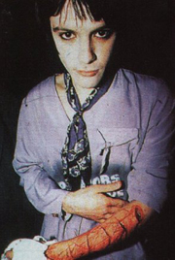
Borderline Personality Disorder
they will take their anger out on themselves, causing themselves injury
Suicidal threats and actions are not uncommon
They are quick to anger when their expectations are not met.

Slide 8
Histrionic Personality Disorder
constant attention seekers
They need to be the center of attention all the time, often interrupting others in order to dominate the conversation.

Slide 9
Histrionic Personality Disorder
They may dress provocatively or exaggerate illnesses in order to gain attention.
They also tend to exaggerate friendships and relationships, believing that everyone loves them

Slide 10
Narcissistic Personality Disorder
characterized by self-centeredness
They exaggerate their achievements, expecting others to recognize them as being superior

Slide 11
Narcissistic Personality Disorder
They tend to be choosy about picking friends, since they believe that not just anyone is worthy of being their friend.
They are generally uninterested in the feelings of others and may take advantage of them.

Slide 12
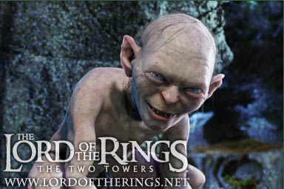
Schizoid Personality Disorder
People with schizoid personality disorder avoid relationships and do not show much emotion
They genuinely prefer to be alone and do not secretly wish for popularity.

Slide 13
Schizoid Personality Disorder
They tend to seek jobs that require little social contact
Their social skills are often weak and they do not show a need for attention or acceptance
They are perceived as humorless and distant and often are termed "loners."

Slide 14
Schizotypal Personality Disorder
characterized by a need for social isolation, odd behavior and thinking, and often unconventional beliefs such as being convinced of having extra sensory abilities.
Some people believe that schizotypal personality disorder is a mild form of schizophrenia.

Slide 15
Avoidant personality disorder
characterized by a pervasive pattern of social inhibition, feelings of inadequacy, and extreme sensitivity to negative evaluation.
consider themselves to be socially inept or personally unappealing, and avoid social interaction for fear of being ridiculed or humiliated.

Slide 16
Dependent personality disorder
characterized by a pervasive psychological dependence on other people.
has difficulty making everyday decisions without an excessive amount of advice and reassurance from others

Slide 17
Obsessive Compulsive Personality Disorder
characterized by a general psychological inflexibility, rigid conformity to rules and procedures, perfectionism, and excessive orderliness.
people with OCPD tend to stress perfectionism above all else, and feel anxious when they perceive that things aren't "right".

